Slide 1





VOLUNTEERS NEEDED!
CALLING ALL VOLUNTEERS! WE NEED YOUR HELP!
Our organization is looking for dedicated individuals to join us in our mission to make a positive impact in our community.
Contact us today to learn more about this exciting volunteer opportunity.
www.alliancegpw.org

Slide 2


Urgently Need
Volunteers
TASK/JOB
  Requirements
  Experience
TASK/JOB
  Requirements
  Experience
Send your resume or questions to Portfolio to hello@ourorganization.org

Slide 3



NAME OF ORGANIZATION
WE ARE
RECRUITING
Role We Need To Fill
Send Resume to
Hello@organization.org

Slide 4




Name of Your Organization Here
WE WANT
YOU!
JOIN OUR COMMUNITY SUPPORT TEAM
VOLUNTEER
OPEN POSITIONS:
  Website Designer
  Graphic Designer
  Marketing Staff
  Administrative staff
SUBMIT YOUR RESUME
Send your resume
For More Information
  hello@reallygreatsite.com
  your website+logo.com

Slide 5
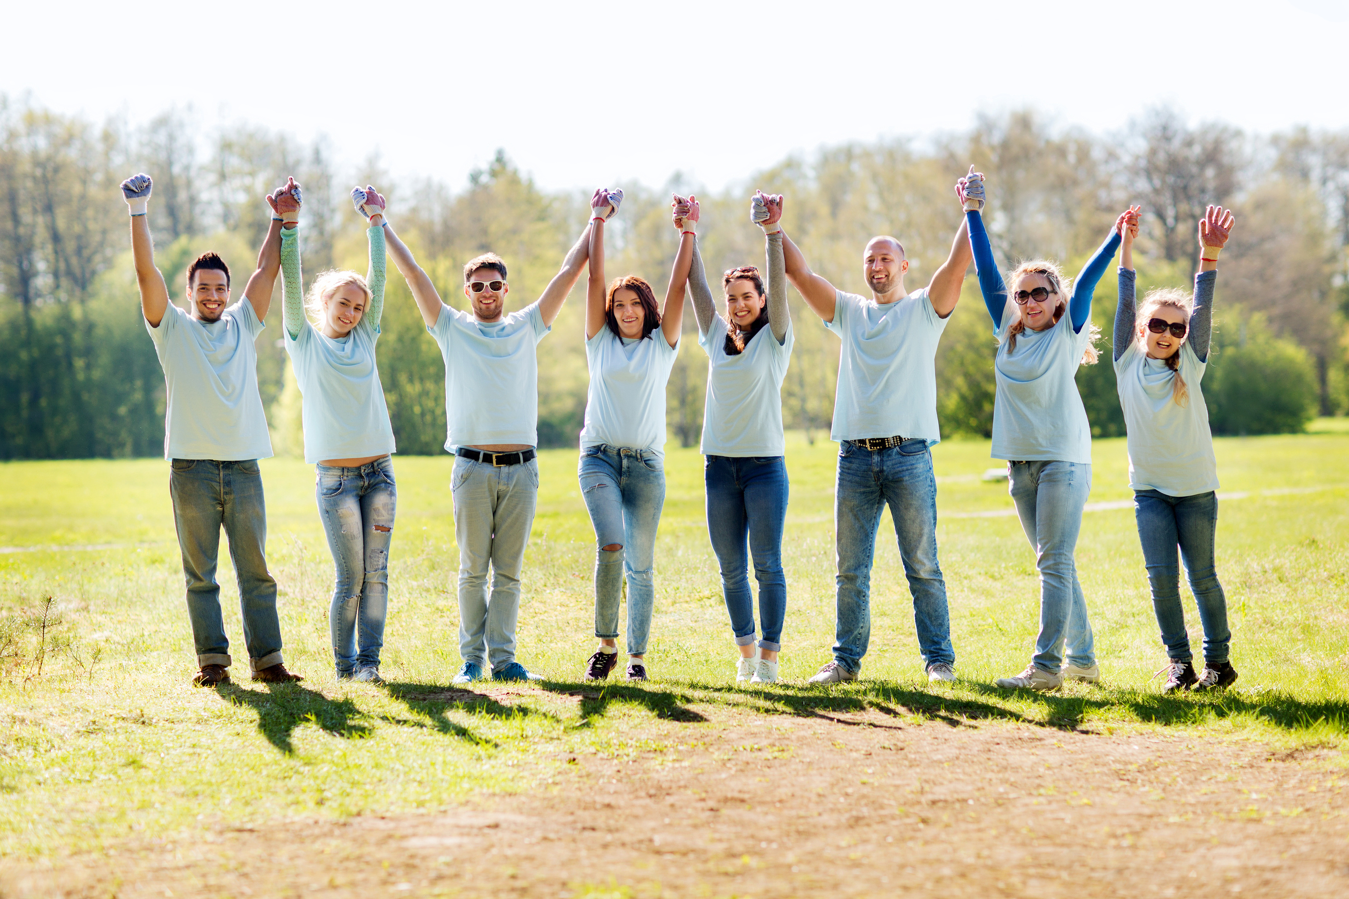



VOLUNTEERS
NEEDED
Let's all contribute to helping individuals who are experiencing financial difficulty.
Benefit
Snack & Breakfast
Merchandise
T-Shirt
JOIN US
www.reallygreatsite.com

Slide 6



Why
Volunteer at
XYZ Church?
Personal growth and skill developmen
Networking and building relationships
Improving one's mental and physical health
www.websitehere.org

